Slide 1
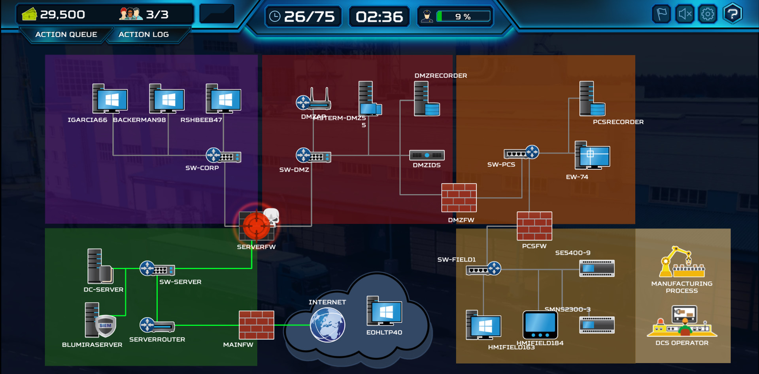


SIT725 Applied Software Engineering
Task 1.3P: Design Your Service
Community
#announcements
#newchallenge
#cyberhelp
#cyberbuddies
thestranger
Level: 13
Cyber
Security
As a Cybersecurity Analyst, I would like to build a tight-knitted cybersecurity community that provides opportunity for learning, collaboration and knowledge sharing through gamification in a safe environment. The integration of gamification elements will allow for a more engaging and enjoyable user experience.
My website will provide the platform where users are able to create a profile and earn rewards for challenges completed. Challenges can be created by any users and may be completed by any other users as well. Challenges may be simulated real-world cybersecurity incidents where users have to identify and investigate the vulnerabilities or solve cryptographic puzzles. I hope to showcase difficult challenges through my expertise and provide this as a shared learning experience for all. This would also help other users seek feedback and advice from others when they are facing their real-world incident.

